Slide 1
Cybersecurity in China
Olivia Alberts

Slide 2
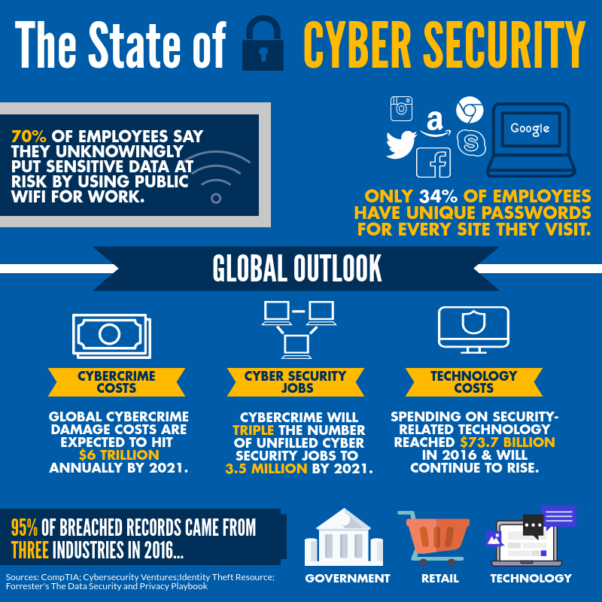
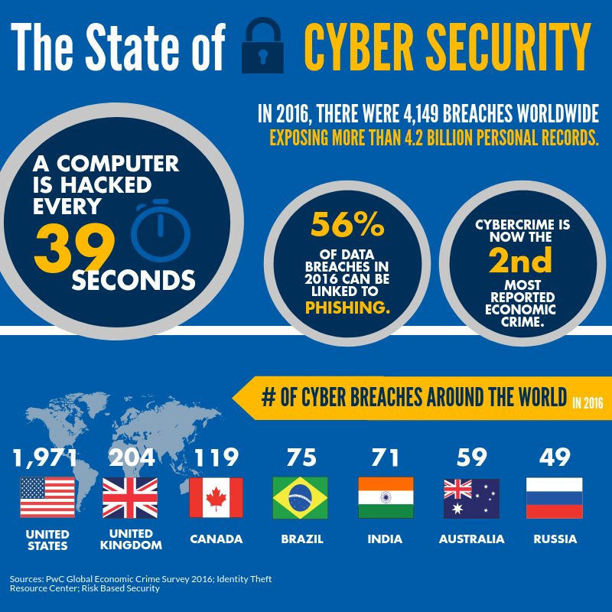
Cybersecurity is becoming an increasingly prominent issue in our world.

Slide 3

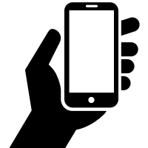
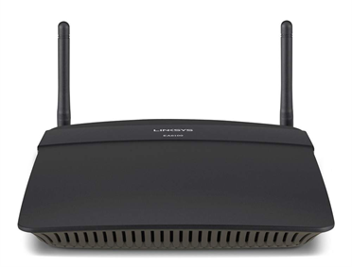
What is Cybersecurity?
“Being protected against cyberthreats; the criminal or unauthorized view of electronic data”
7:00-9:05 in https://www.youtube.com/watch?v=BpdcVfq2dB8
Hacking can happen in many ways, (phishing, etc) but for now we’re going to walk through a common breach of security
It’s called the Starbucks Scam- shows the issues with “free” wifi
When you Google something (using wifi) what’s the path of info?
Someone can go and set up a fake wifi router, putting all of your data is at risk

Slide 4

Activity time!

Slide 5
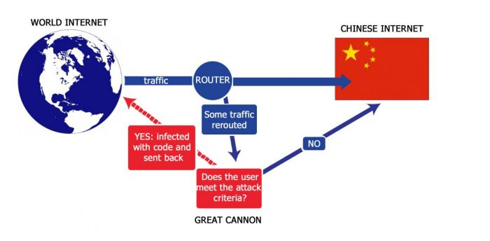
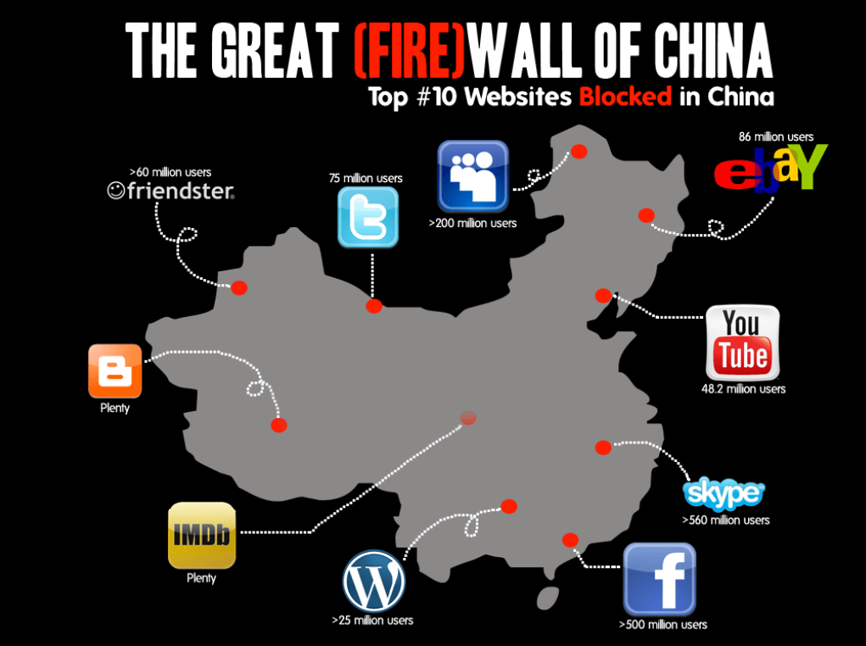
What is China?
One of the largest countries in the world
Communist
In order to hold their power, they have what’s called the “Great Firewall”

Slide 6
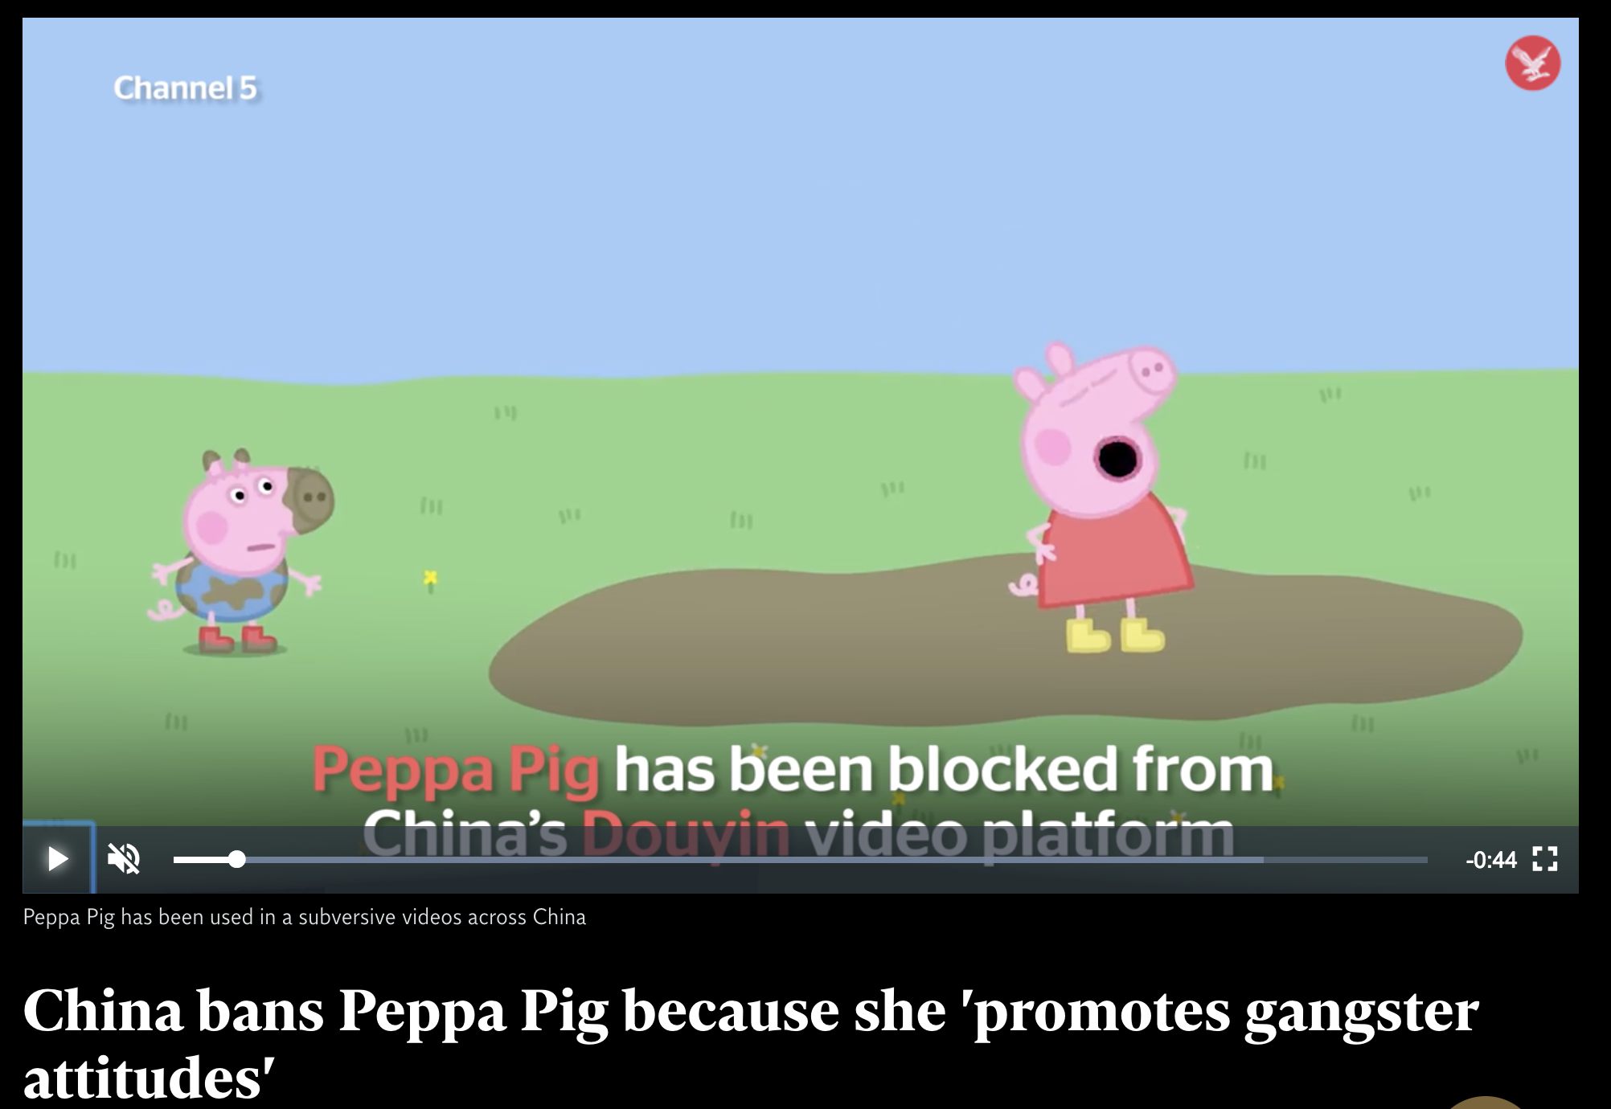
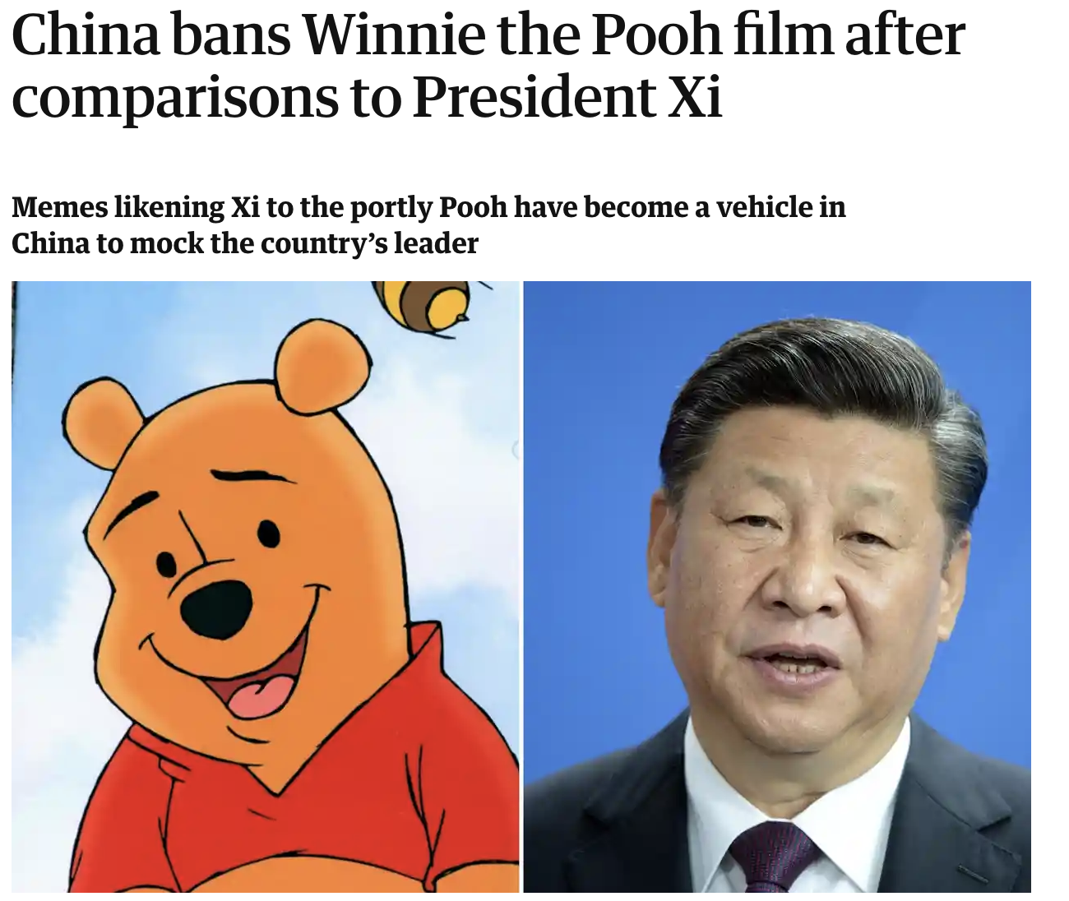


This impacts daily life
Just won’t send certain messages
1:00-1:30

Slide 7

What would you ban?
How might this disrupt politics? The people can’t vote anyways.
What’s the challenge of running a global business and not being able to access important sites?

Slide 8
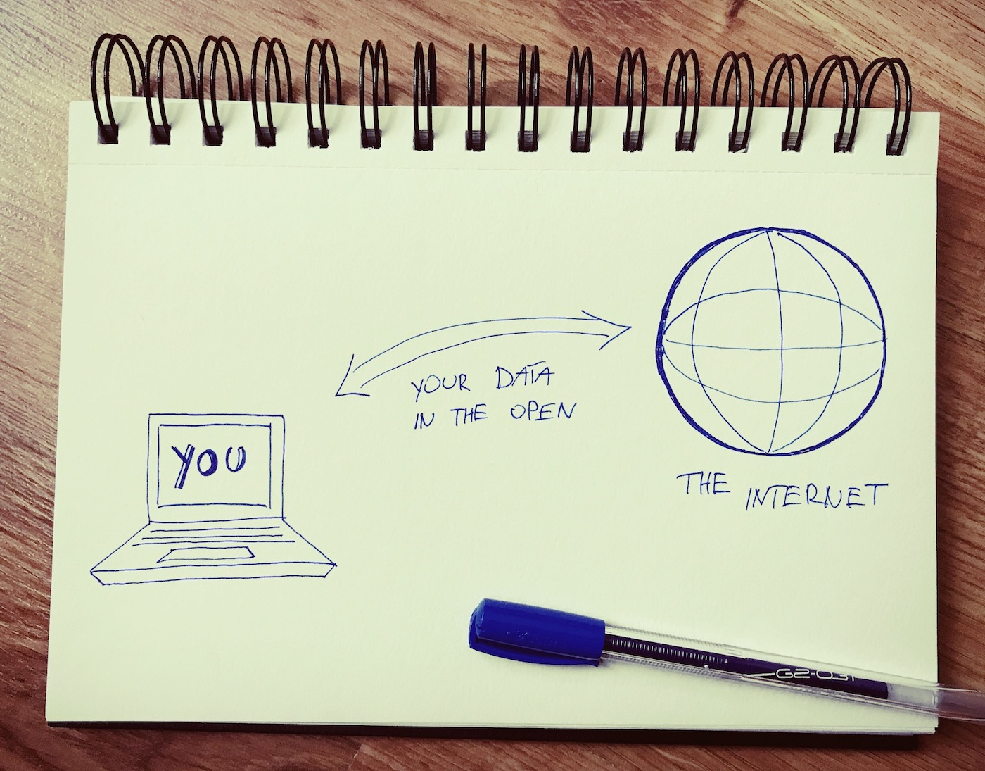
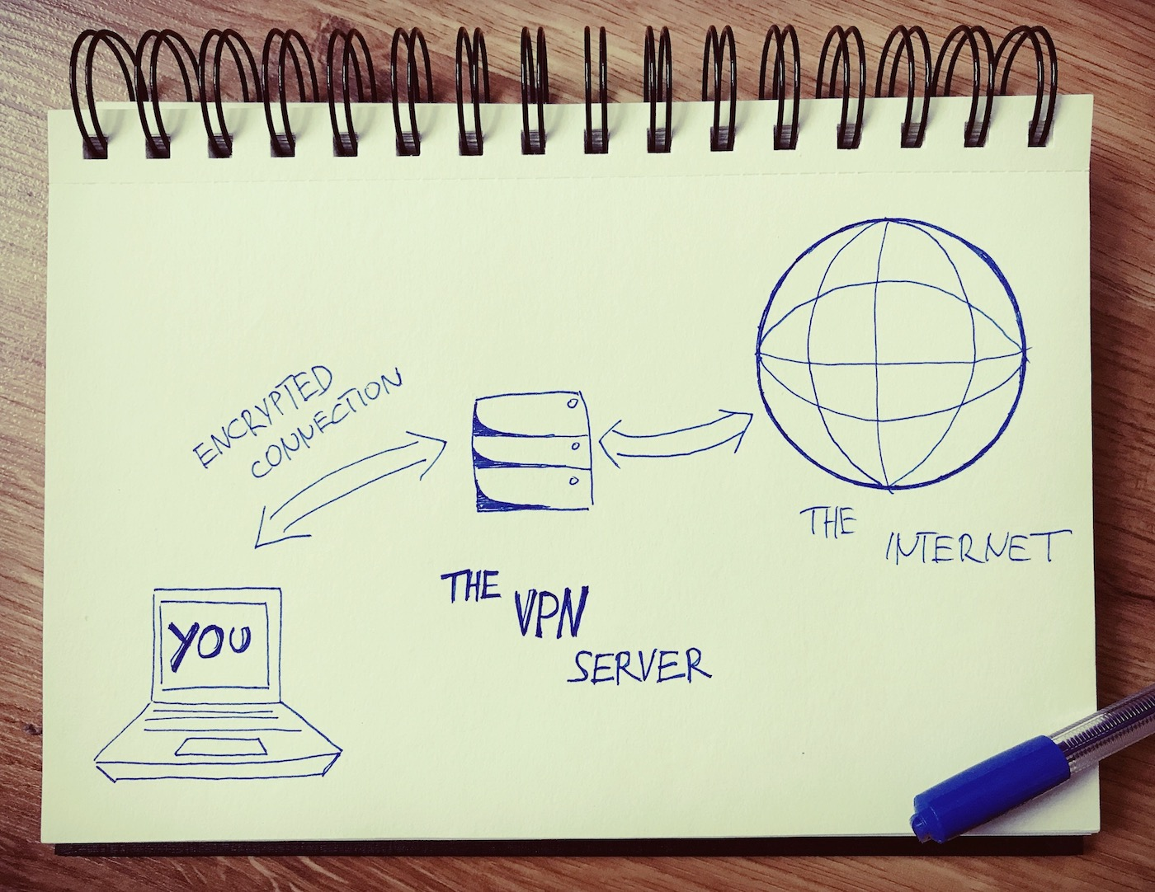
How do people get around this?
VPNs (Virtual Private Networks)
The destination site sees the VPN server as the traffic origin, not you.
No one can (easily) identify you or your computer as the source of the data, nor what you’re doing (what websites you’re visiting, what data you’re transferring, etc.).
Your data is encrypted, so even if someone does look at what you’re sending, they only see encrypted information and not raw data.

Slide 9
Why is it important?
Free internet is important to democracy
0:45-1:25 in https://www.youtube.com/watch?v=ITcZ8I1D9ss
US-China relations are dependent on it

Slide 10
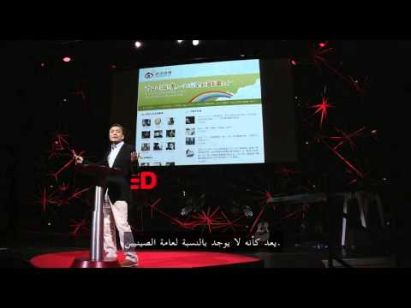
If Time:

